Slide 1
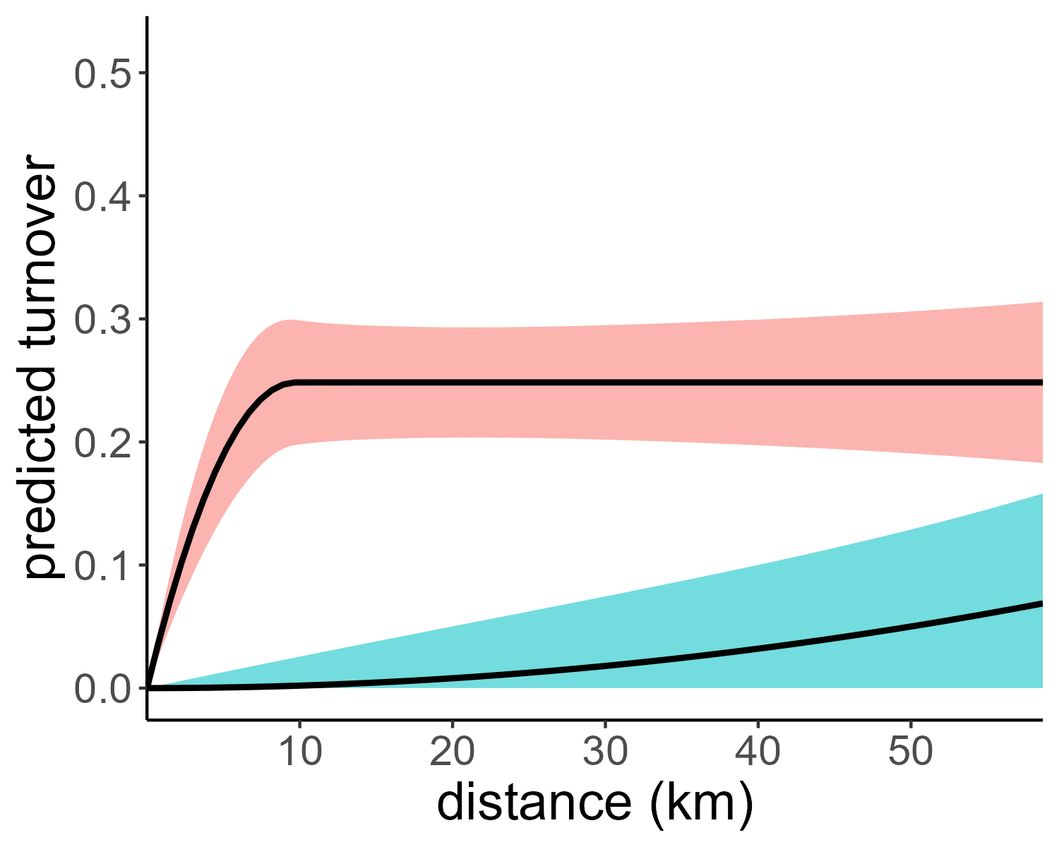
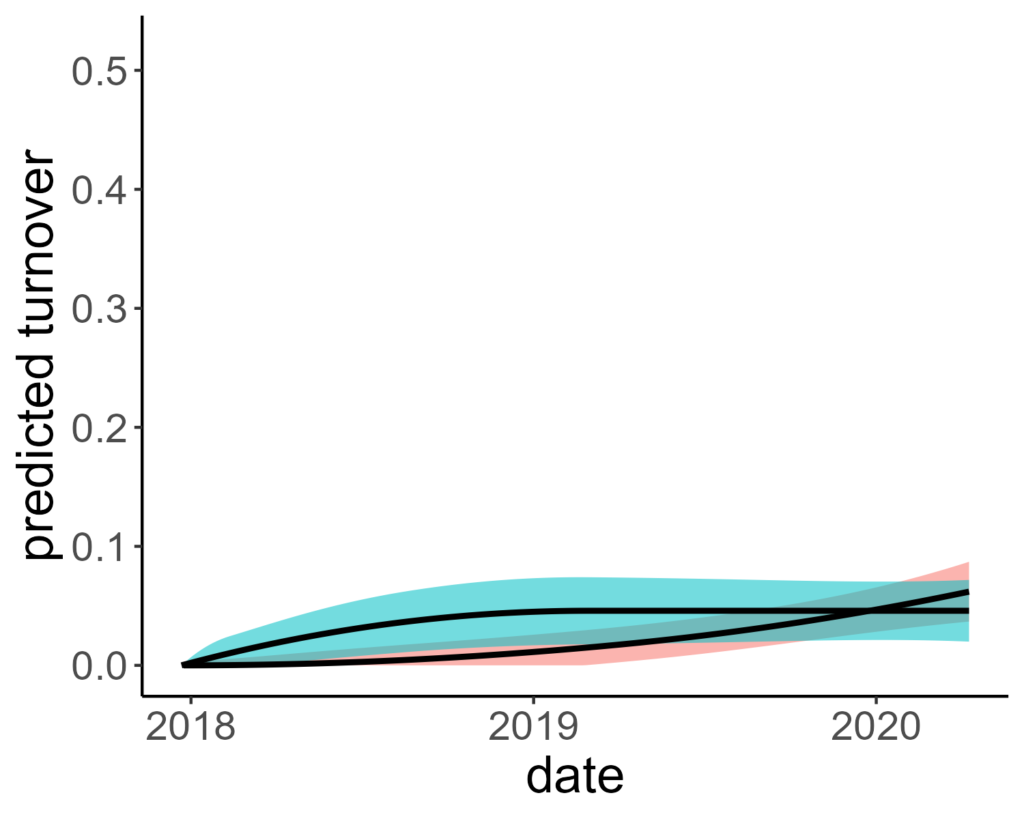
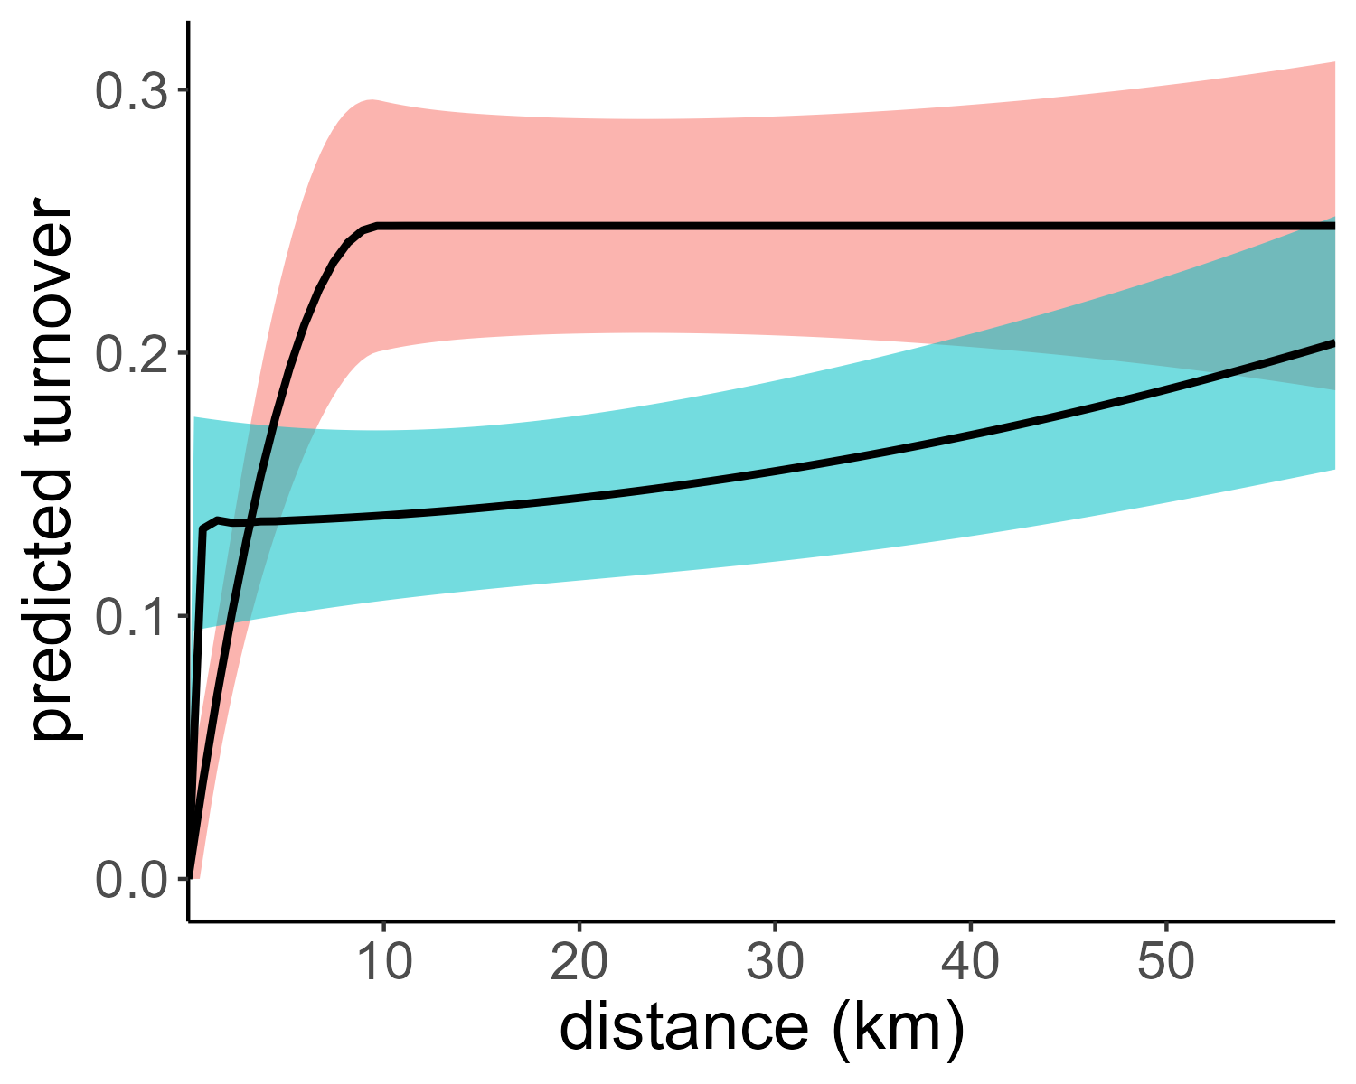
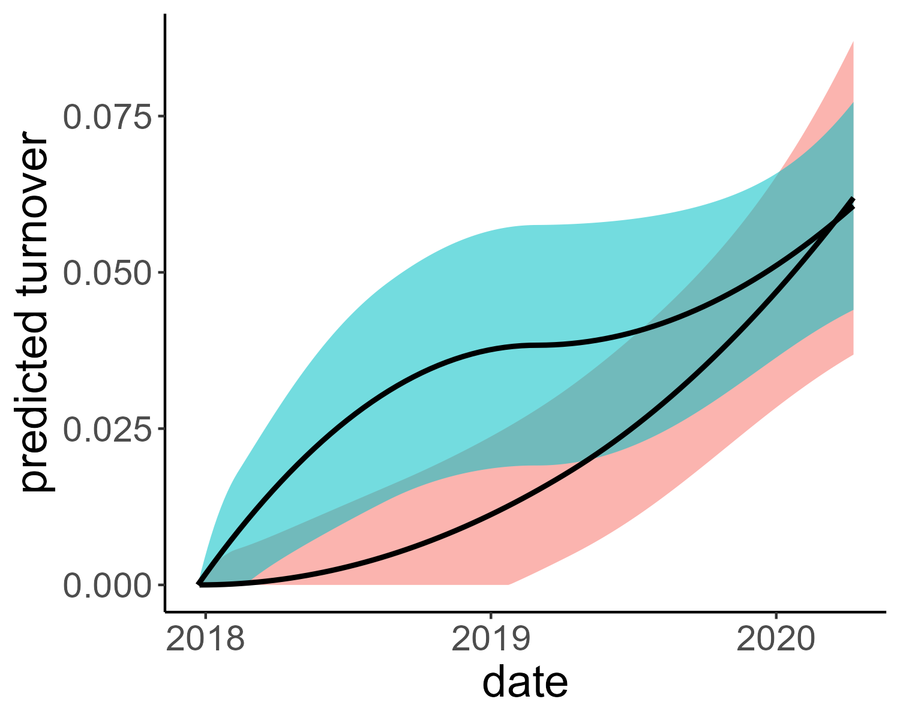
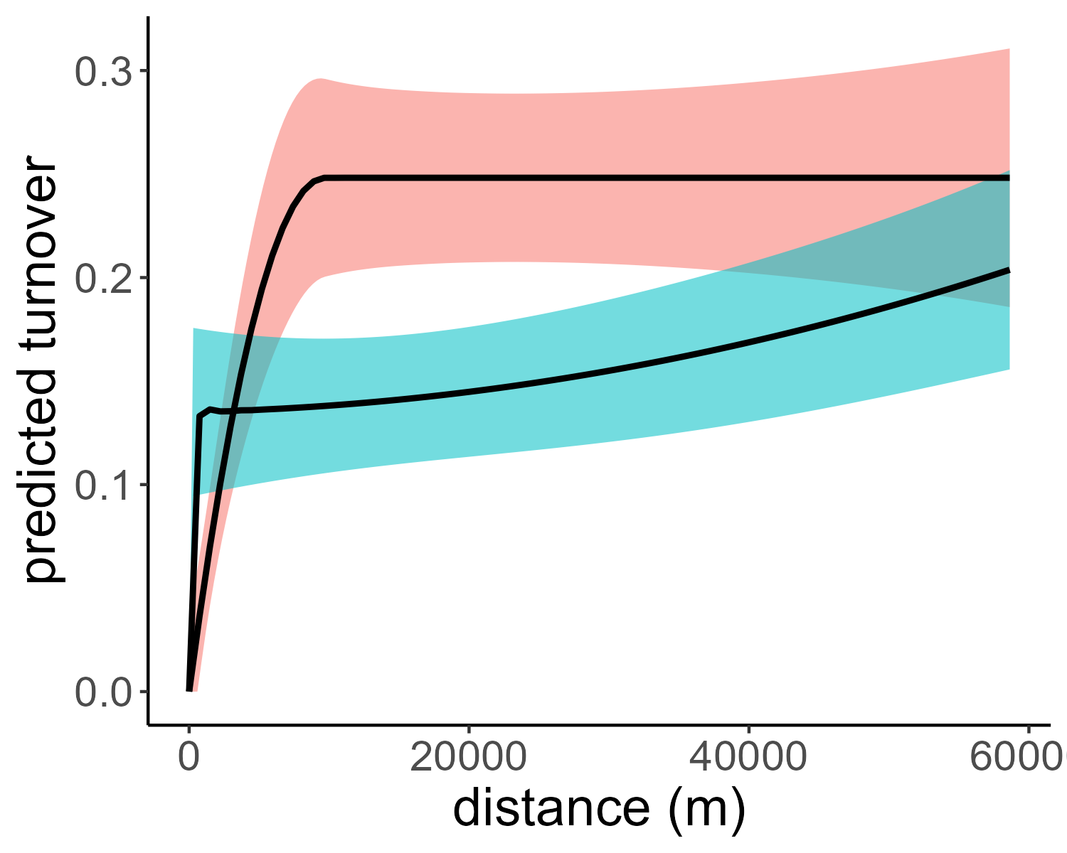
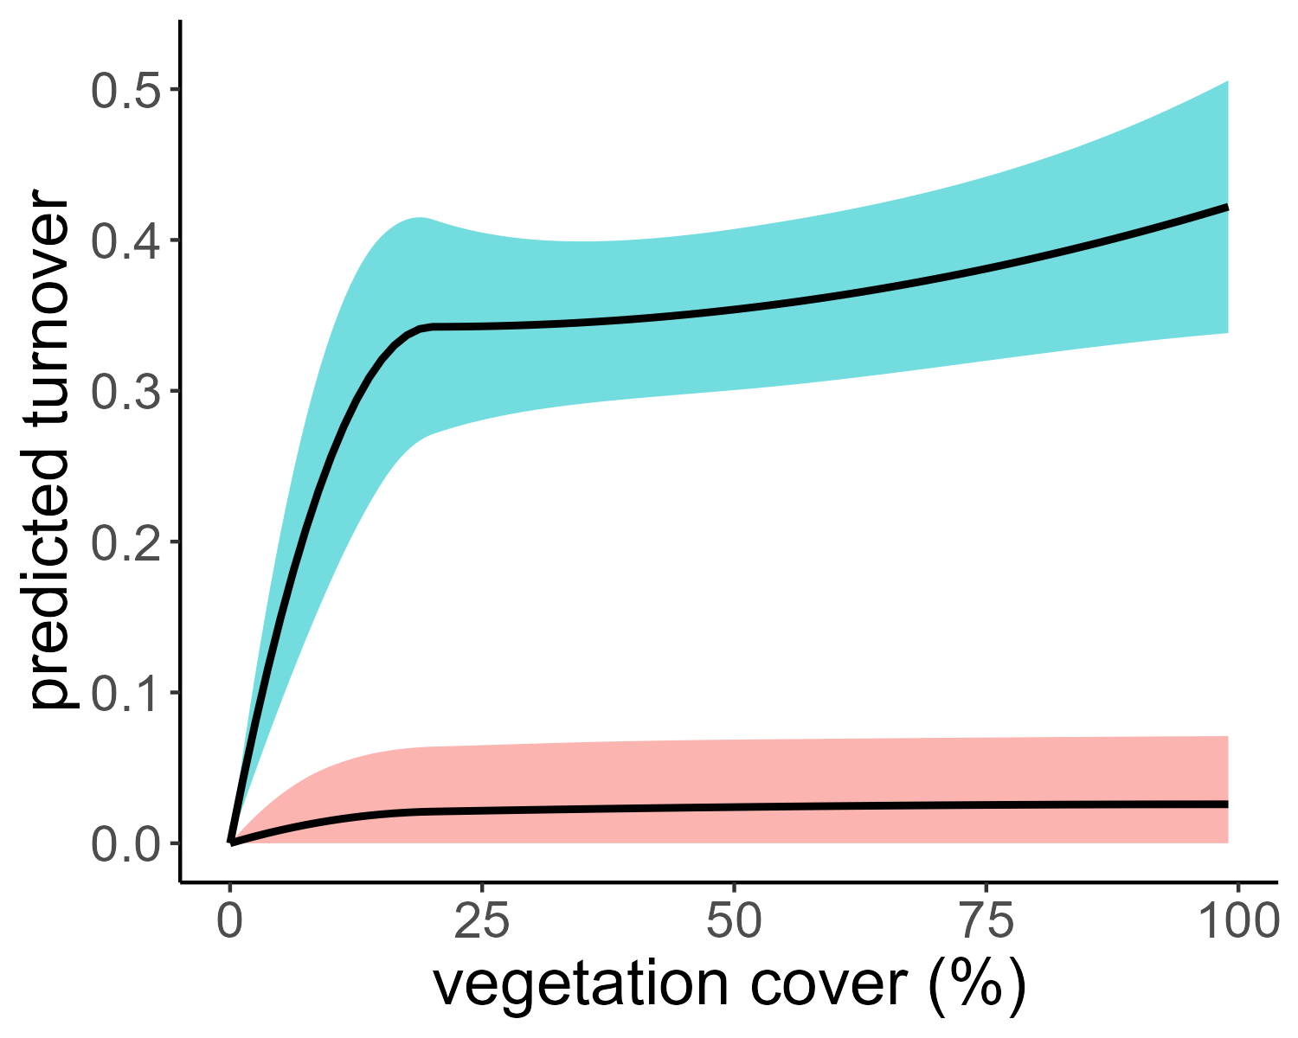
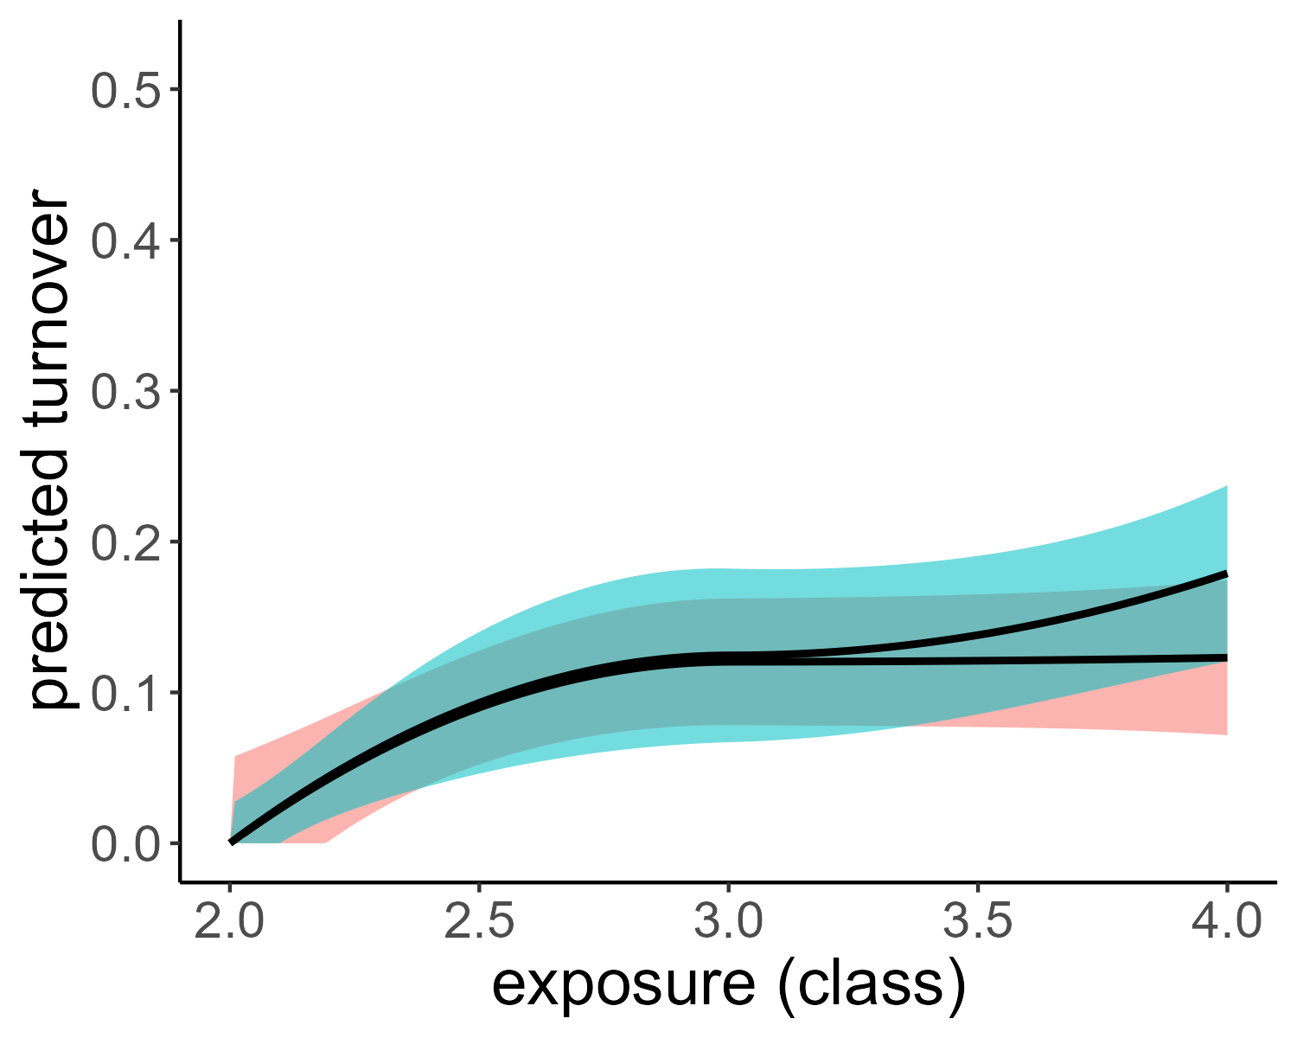
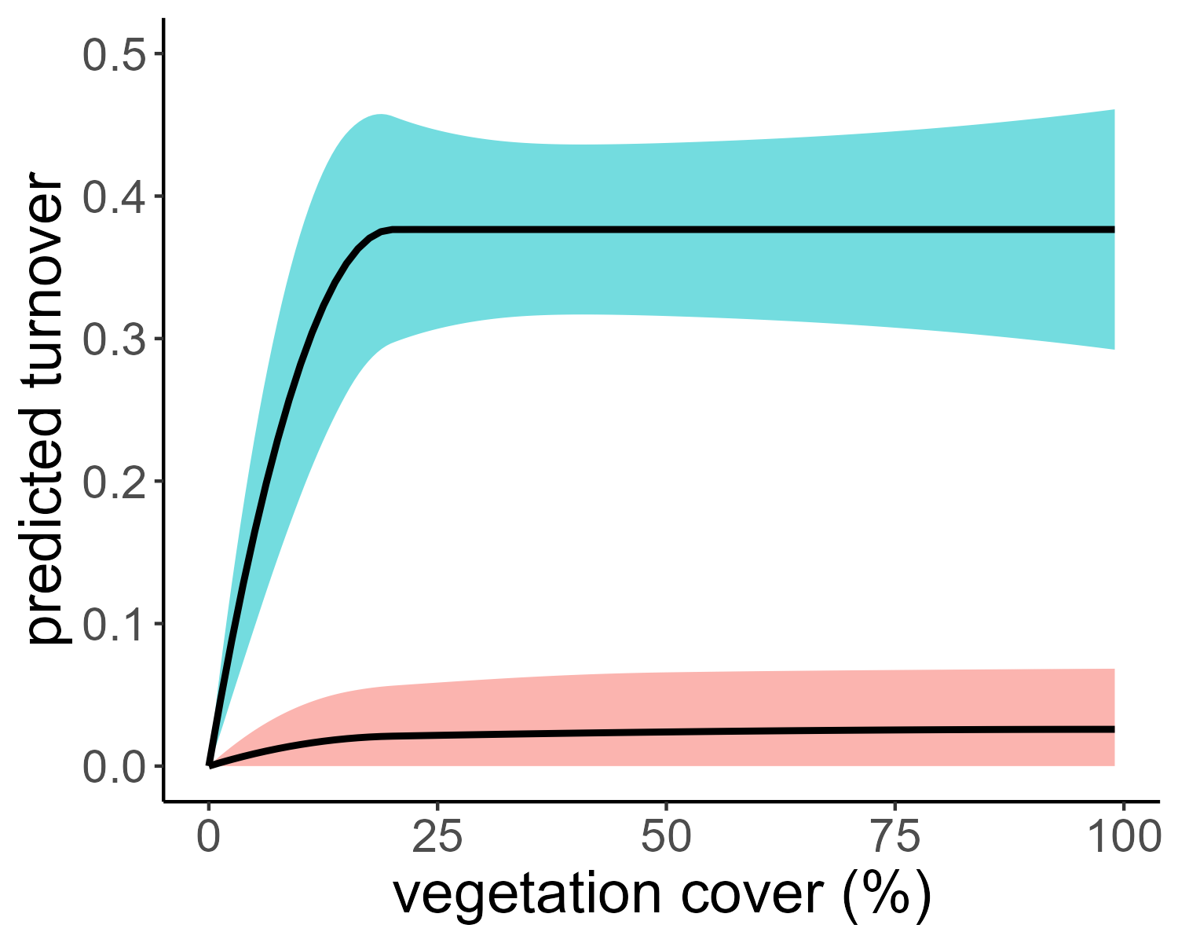
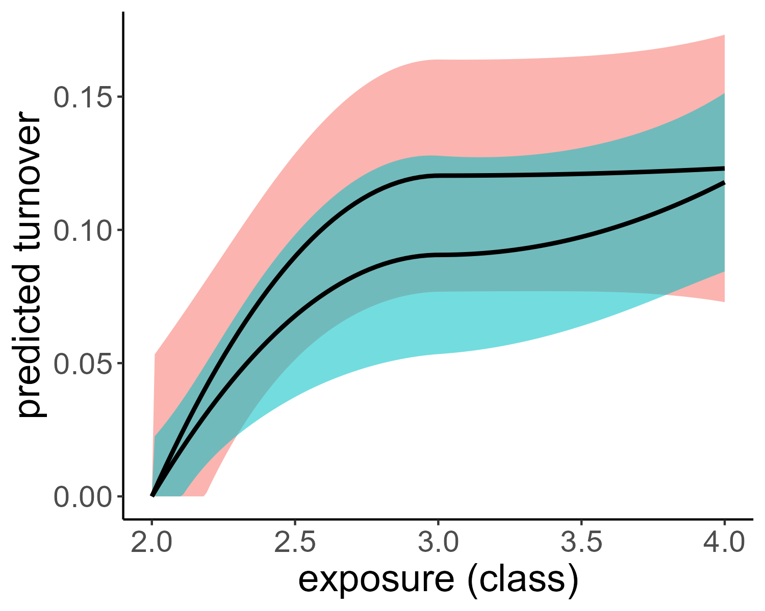
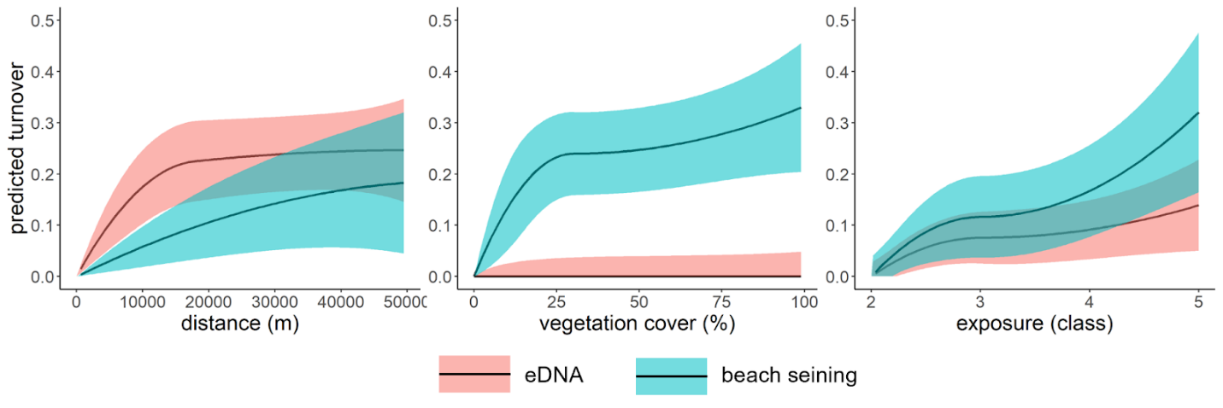
beach seining model
eDNA model

Slide 3
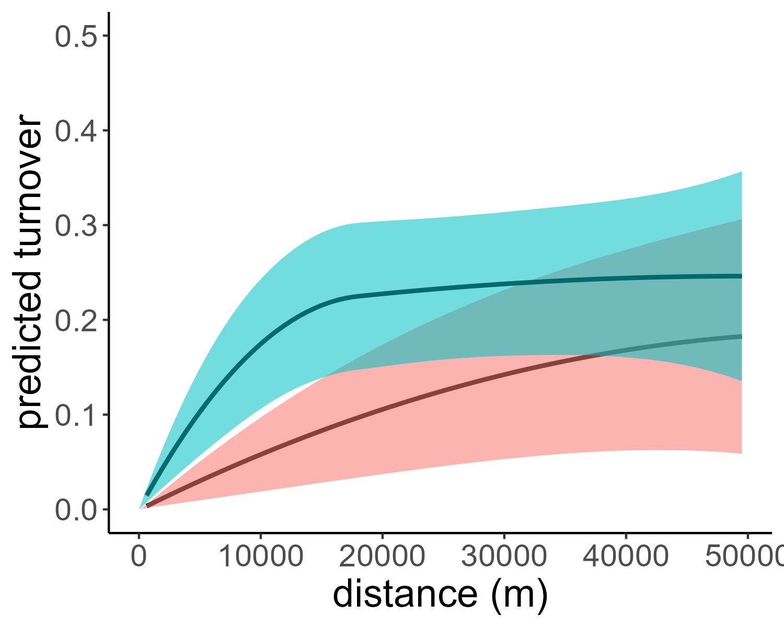
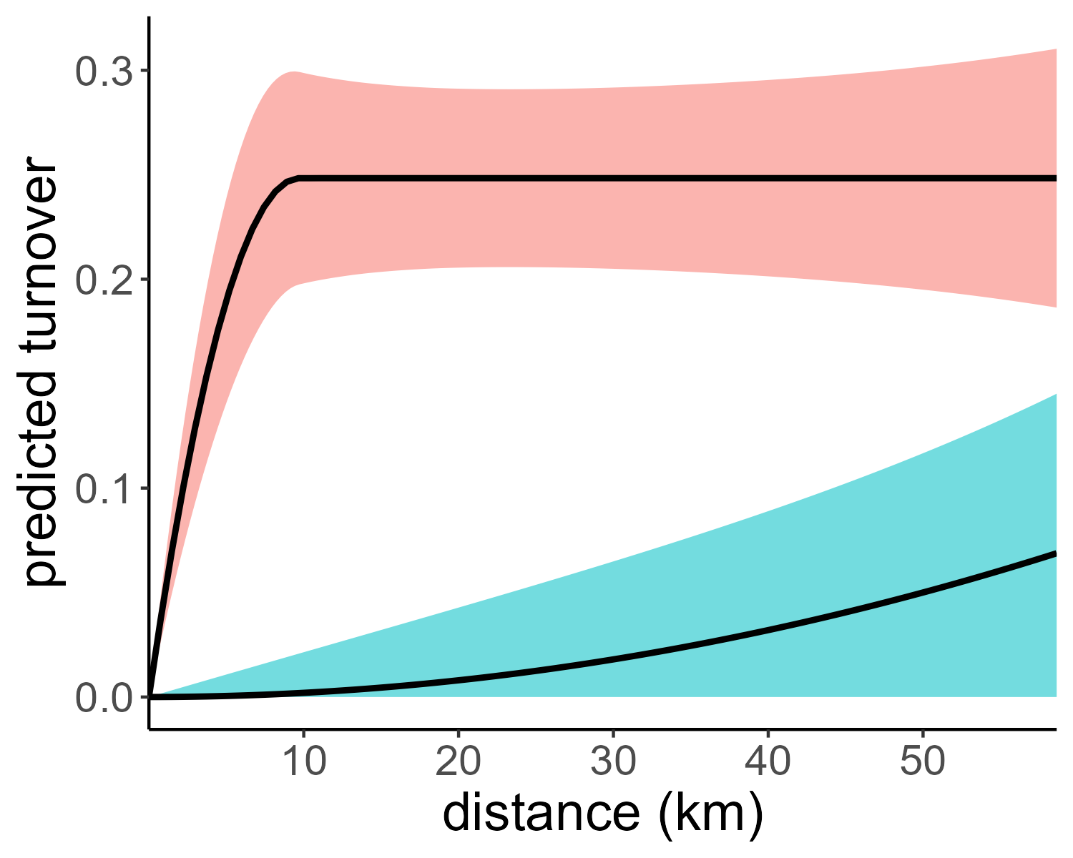
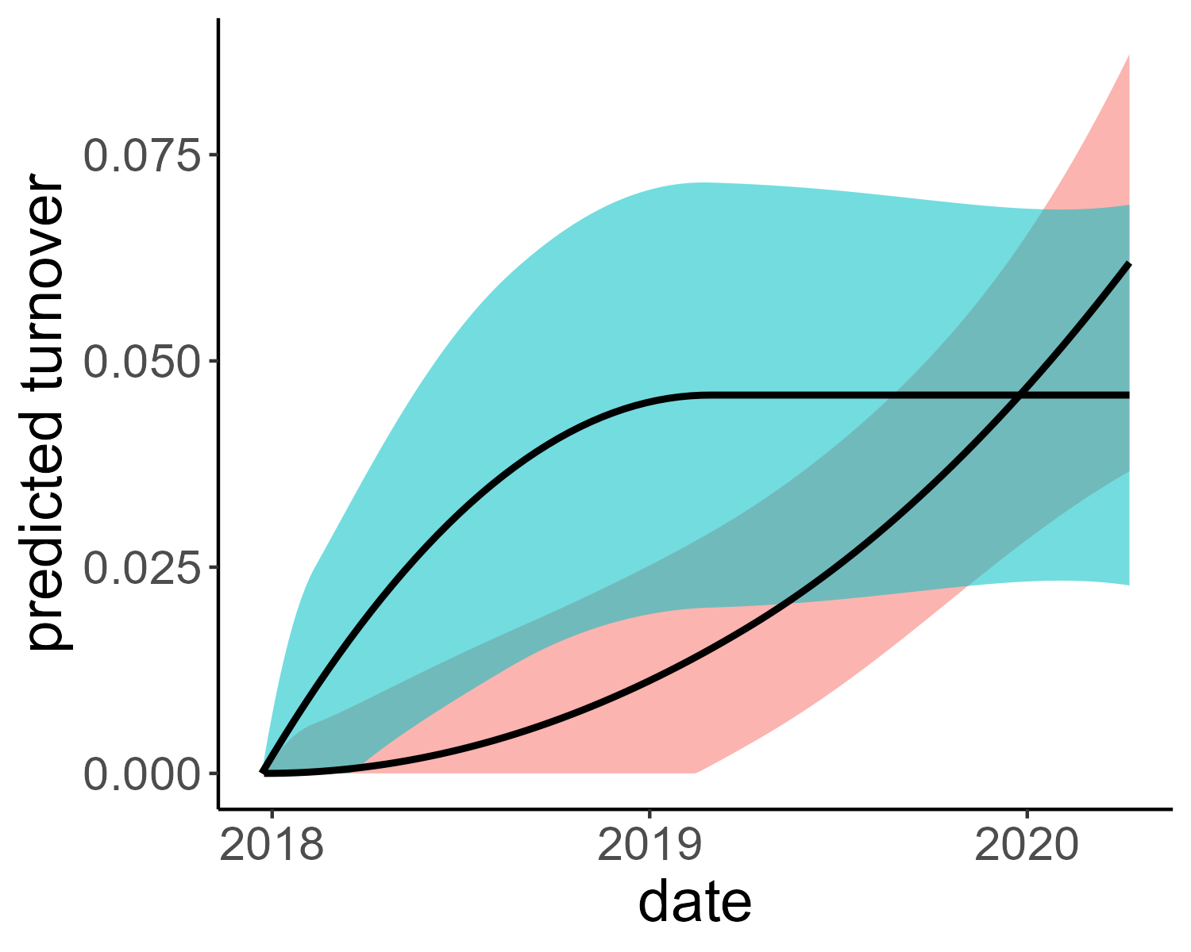
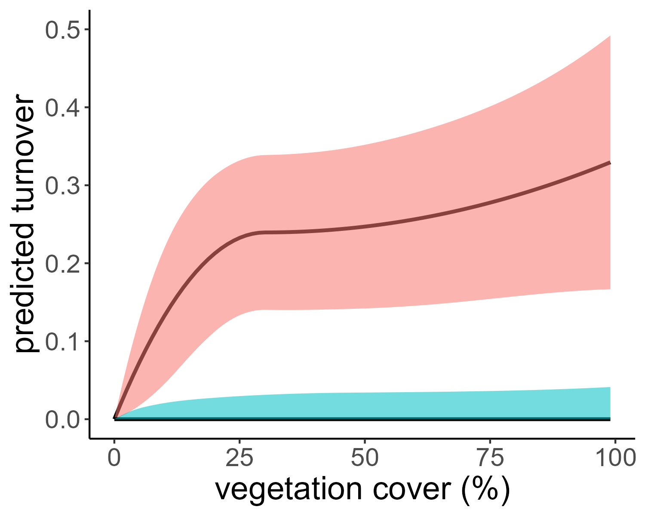
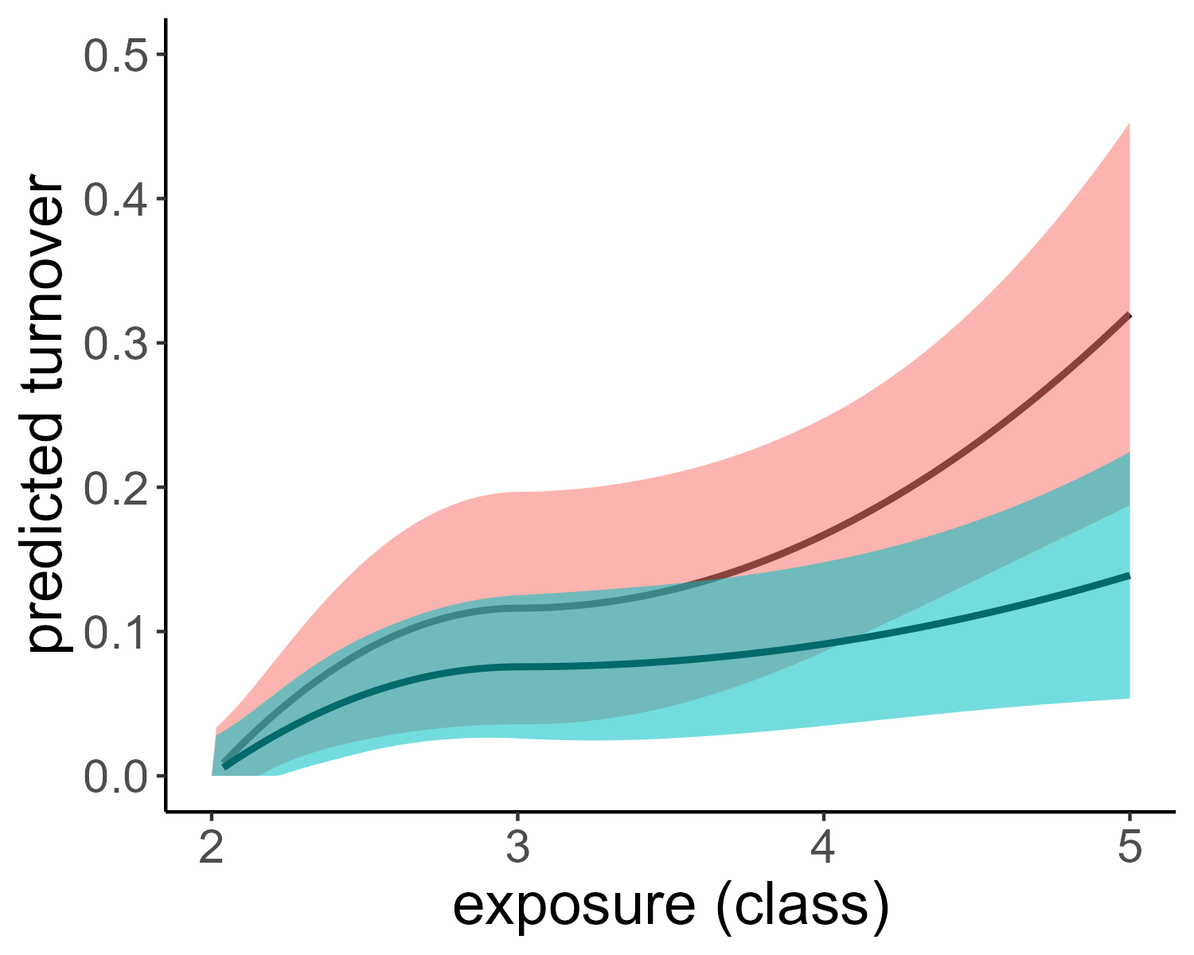
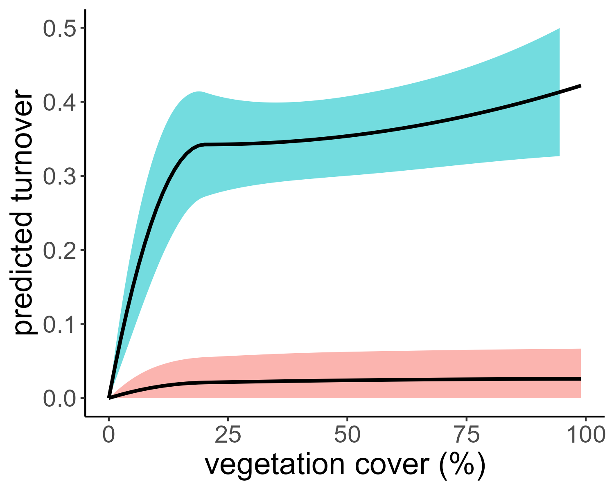
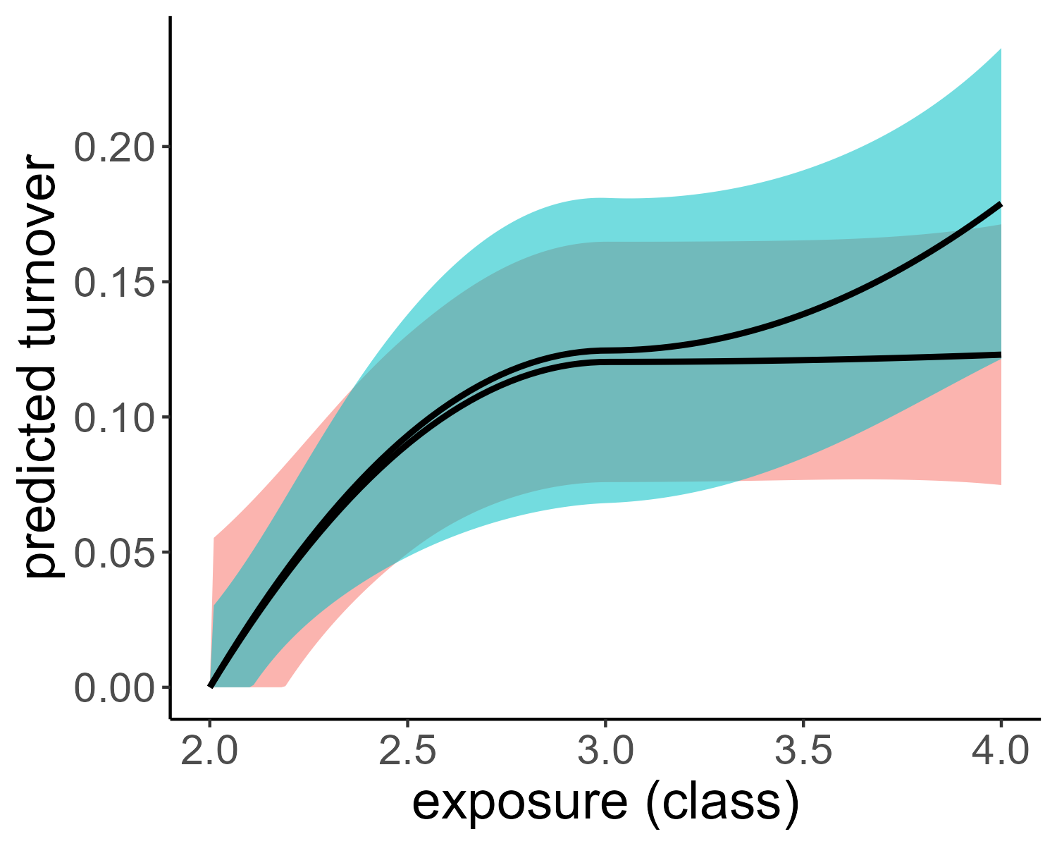
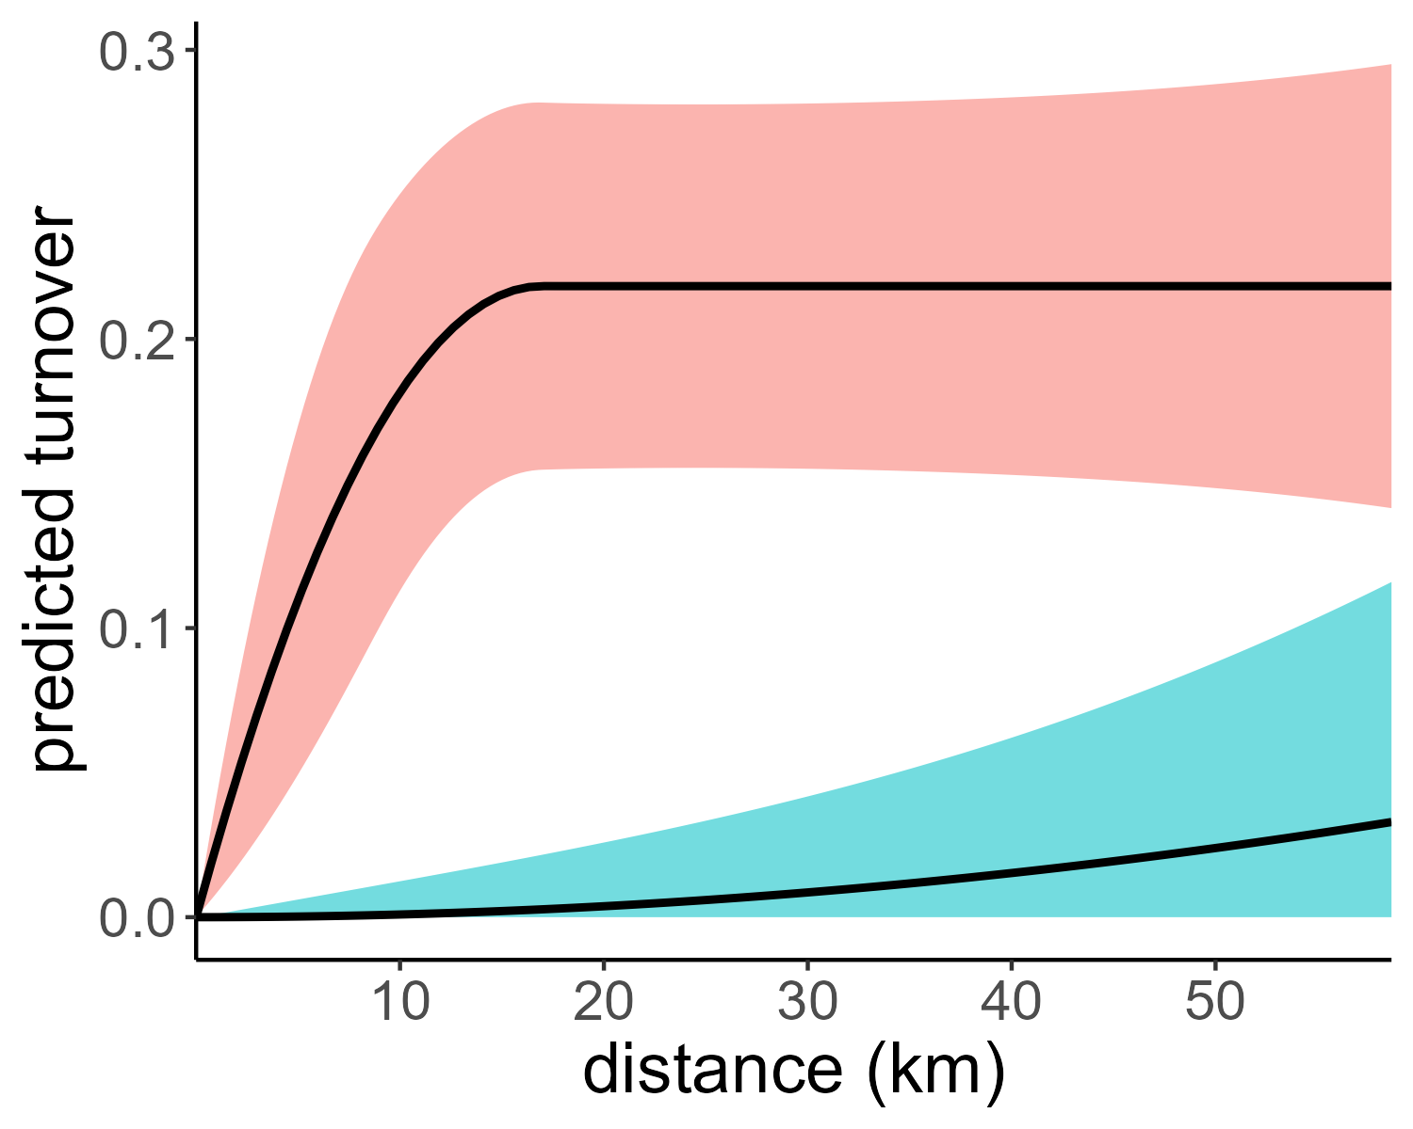
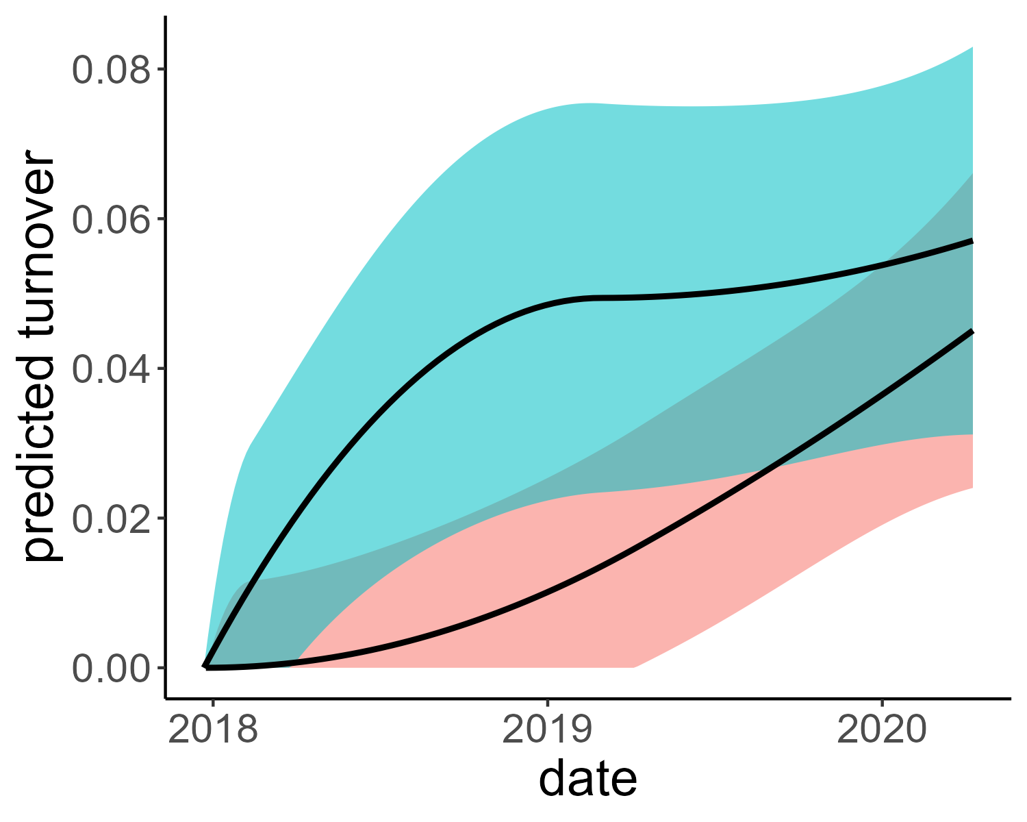
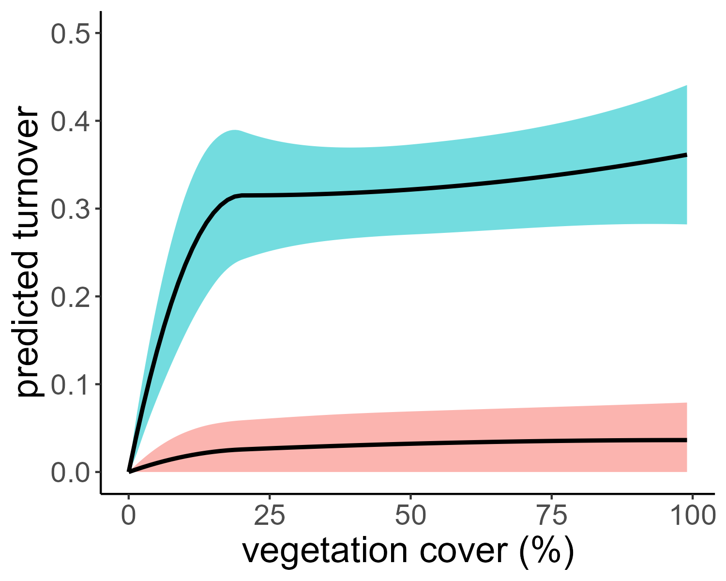
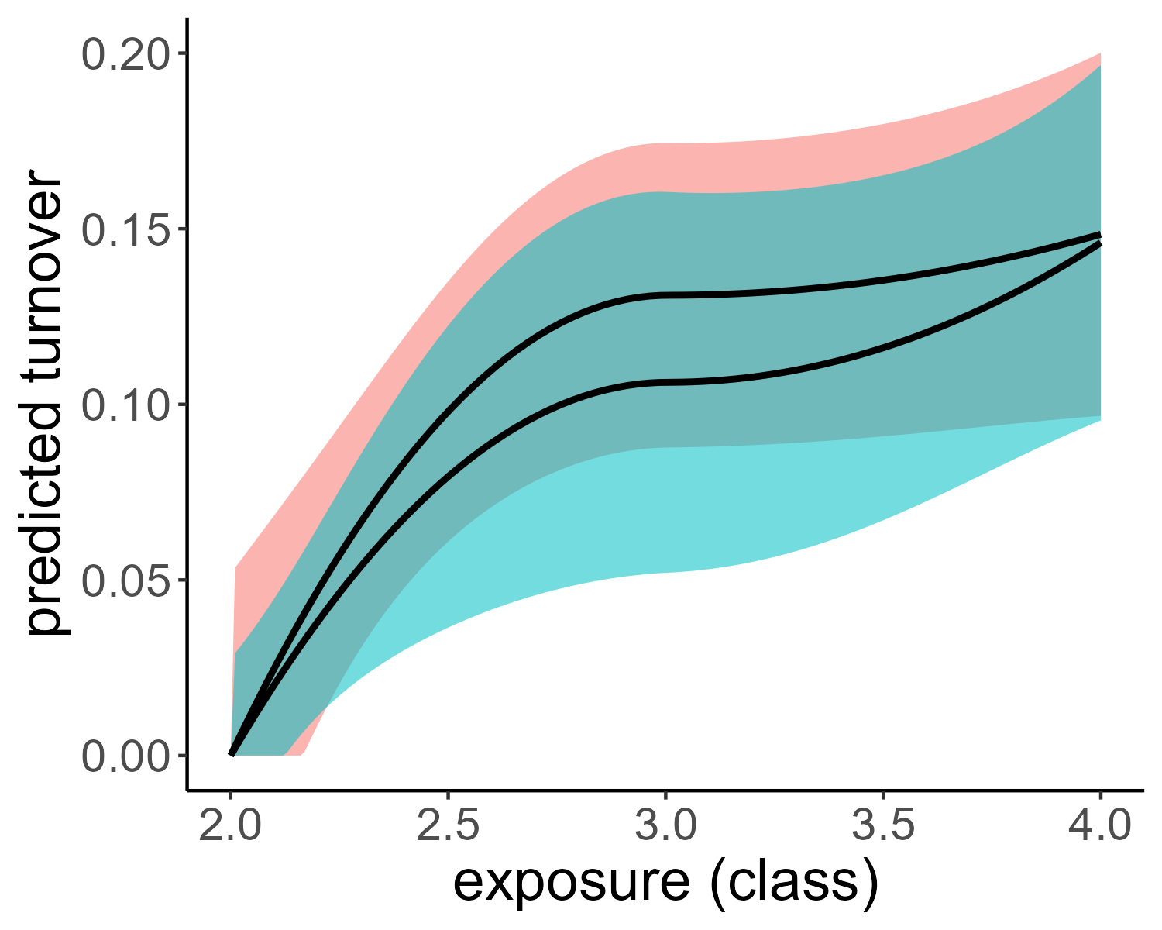
2018 only
beach seining model
eDNA model
all years, 5m distance for within-site pairs
all years
all years, within-site pairs removed

Slide 4
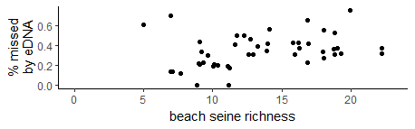
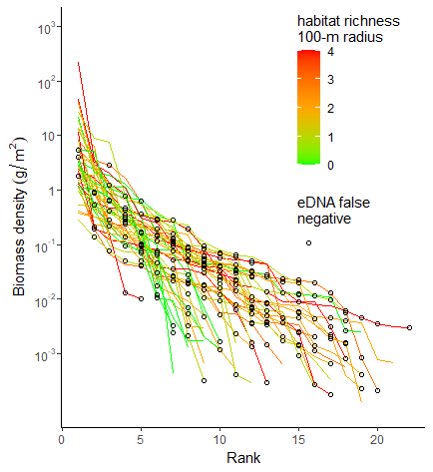
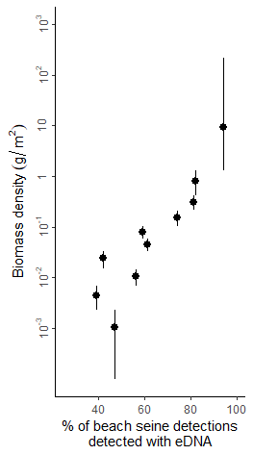
A
B
C

Slide 5
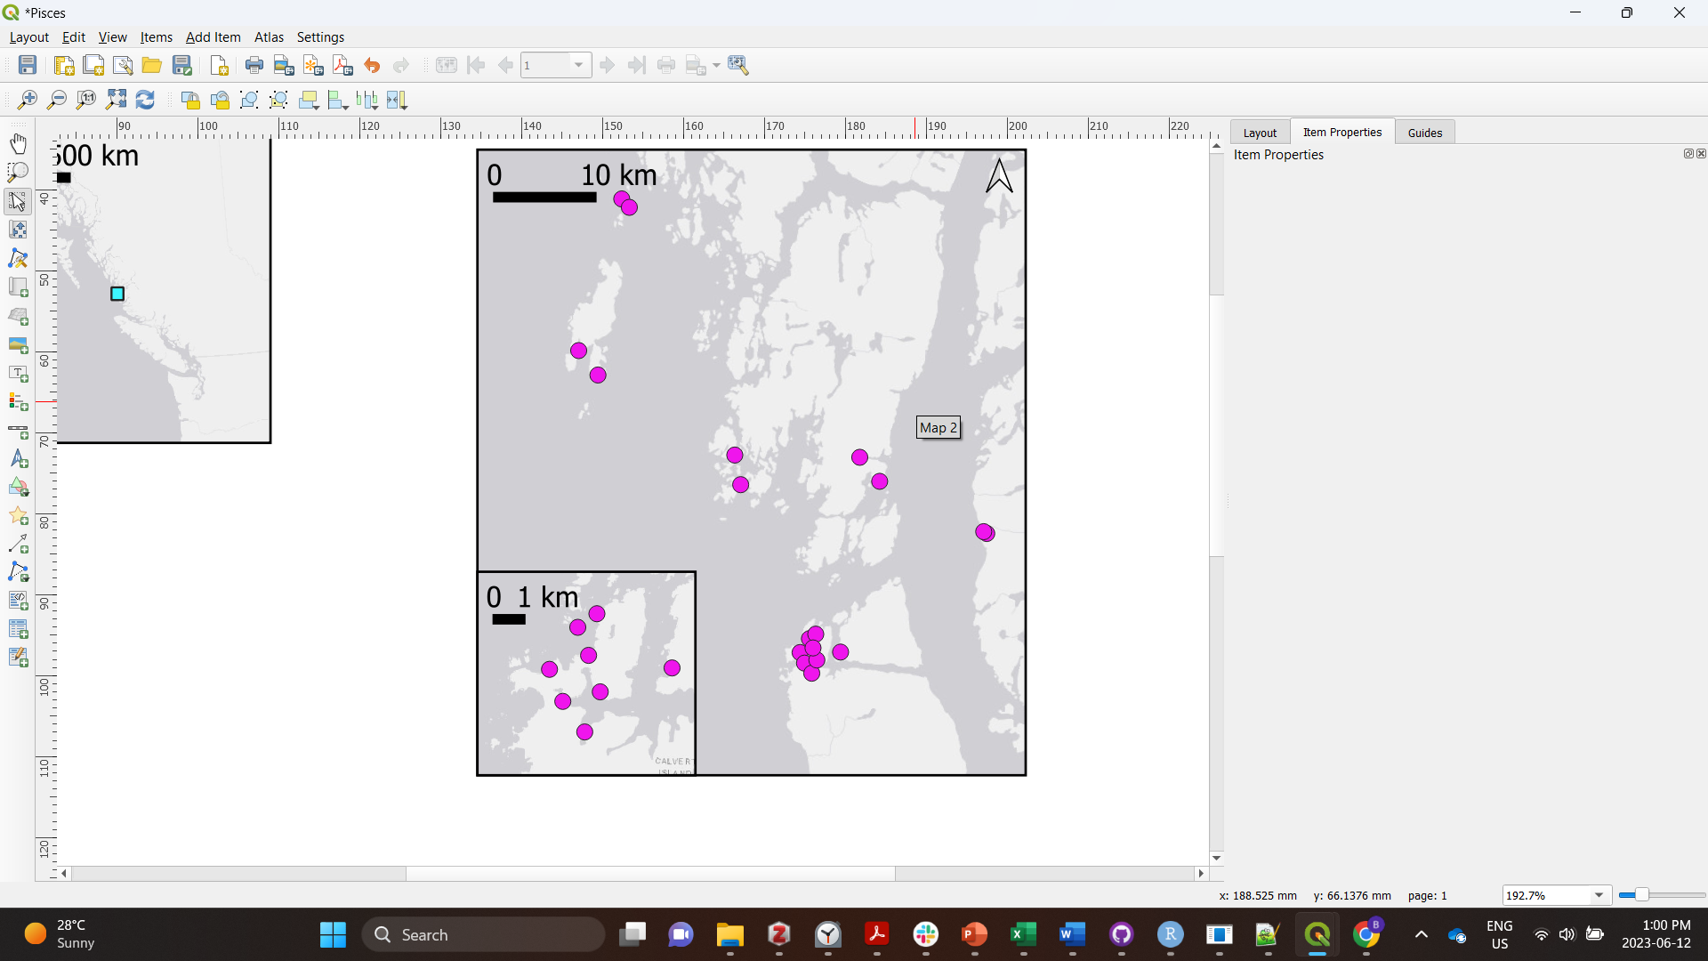
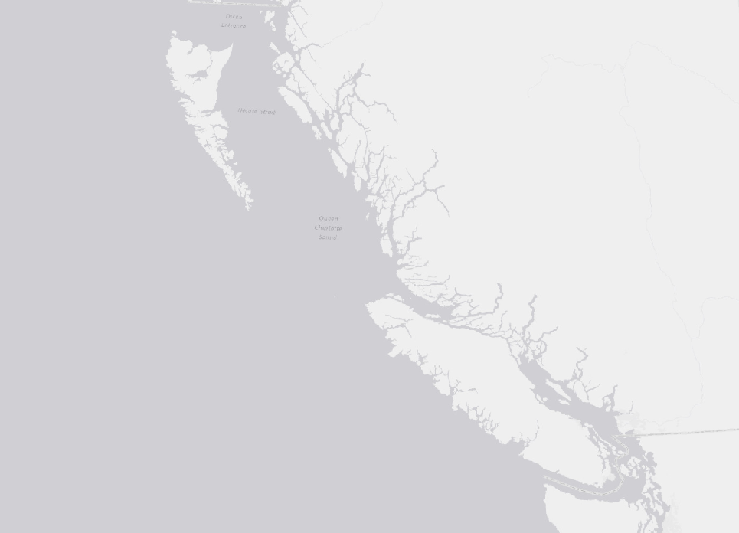
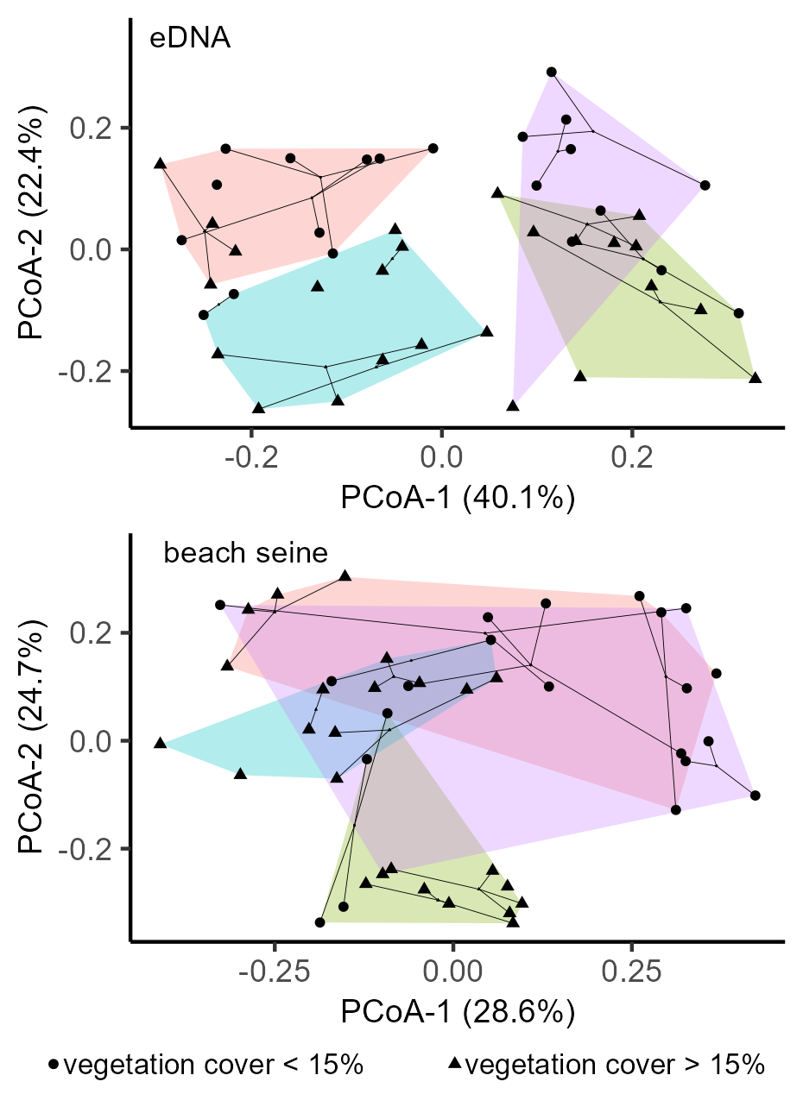
British Columbia
B
Pacific Ocean
A
B

Slide 7
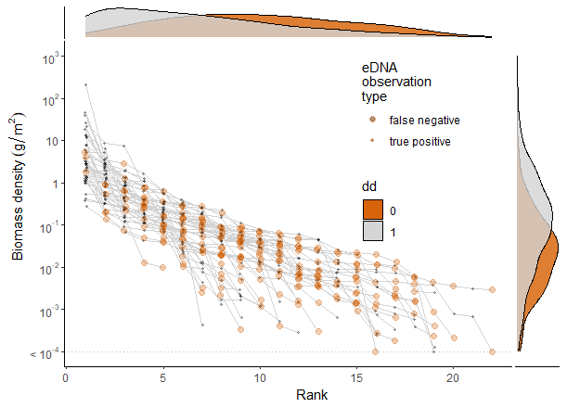
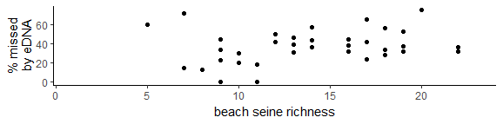
A
B
not detected by eDNA
detected by eDNA
rank biomass density from beach seines
C

Slide 8
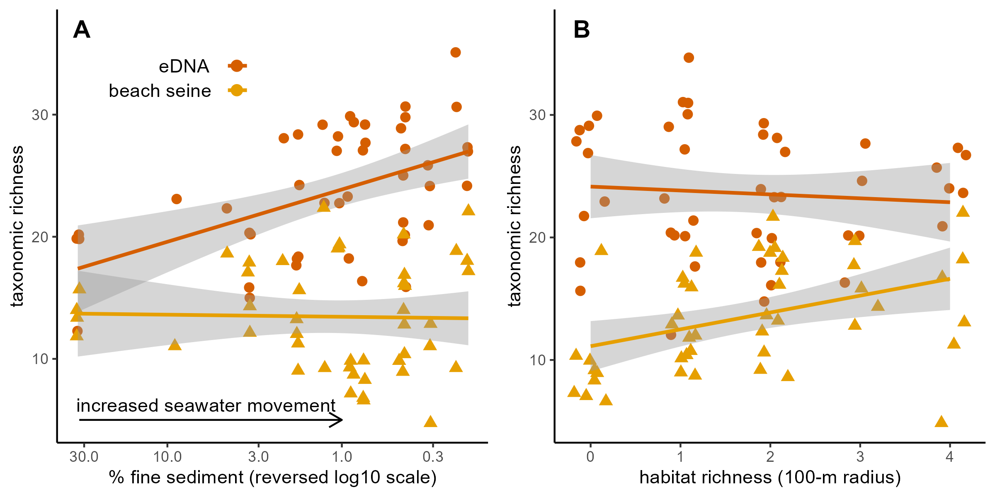

Slide 9
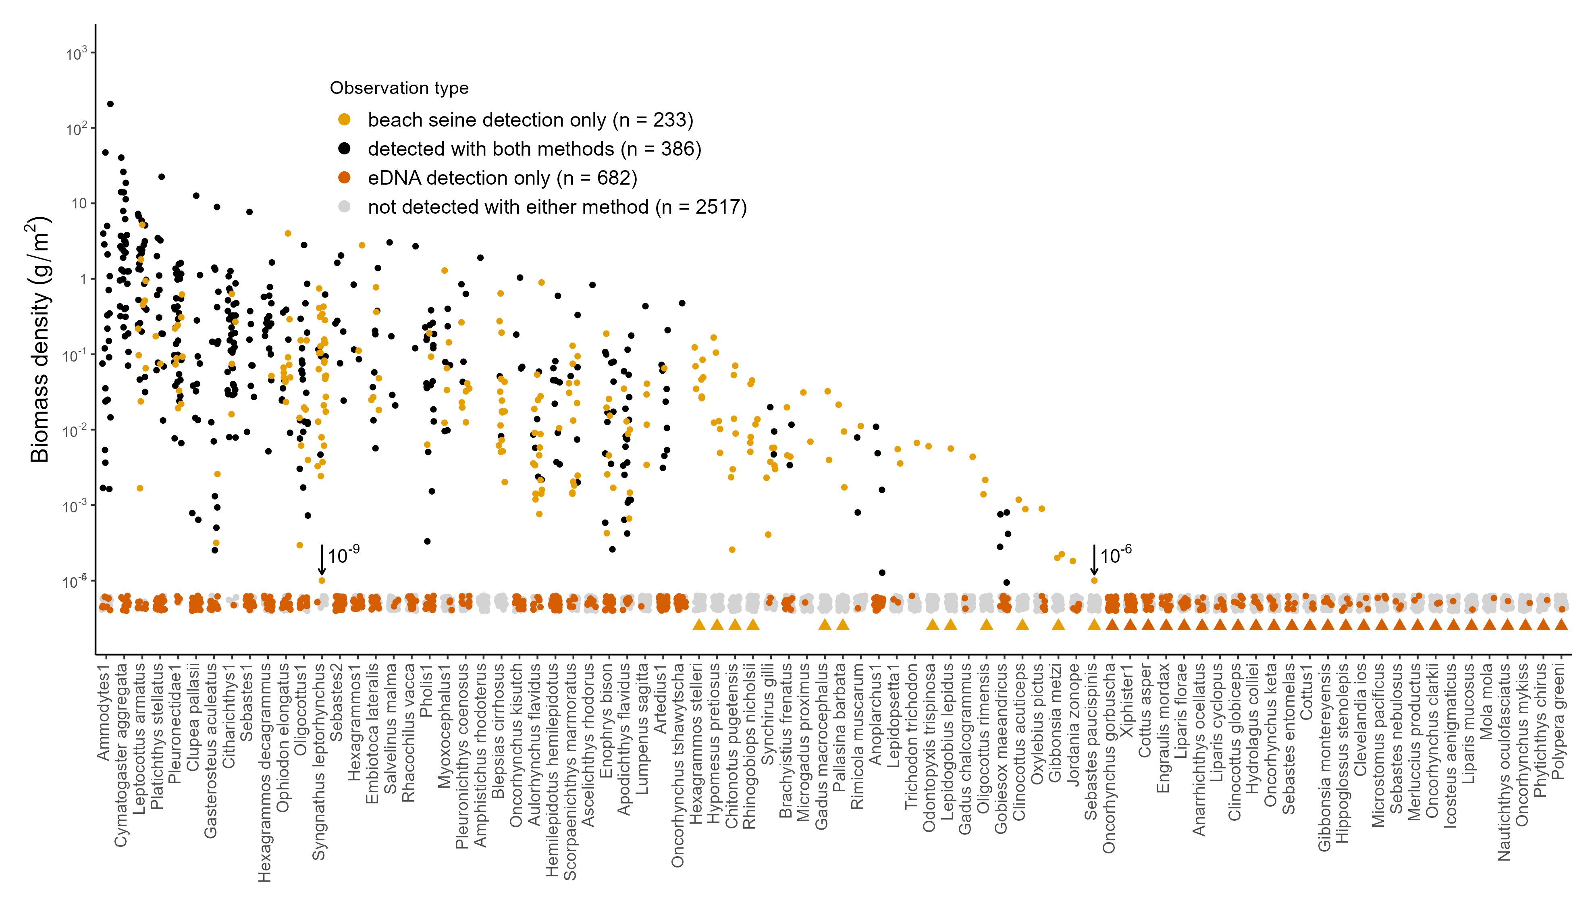
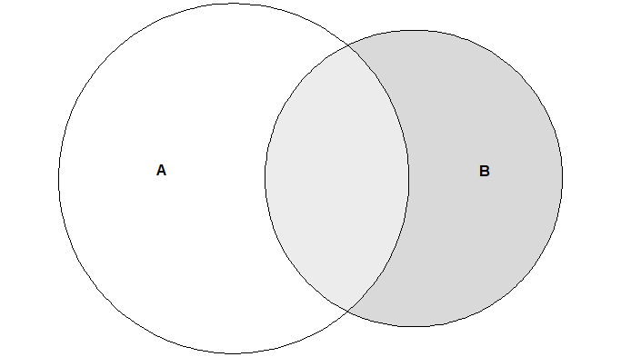
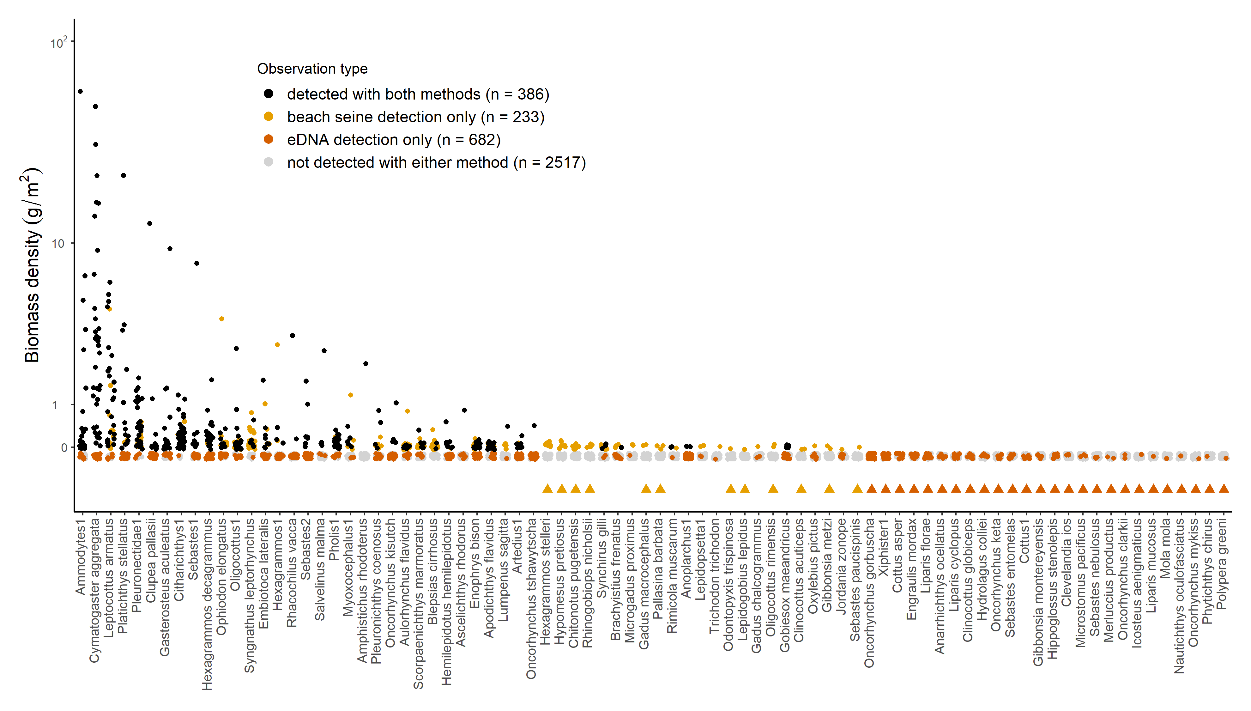
Local observations
detected with both methods (n = 386)
beach seine detection only (n = 233)
eDNA detection only (n = 682)
not detected with either method (n = 2517)
Regional observations
detected only with beach seining
detected only with eDNA

Slide 10
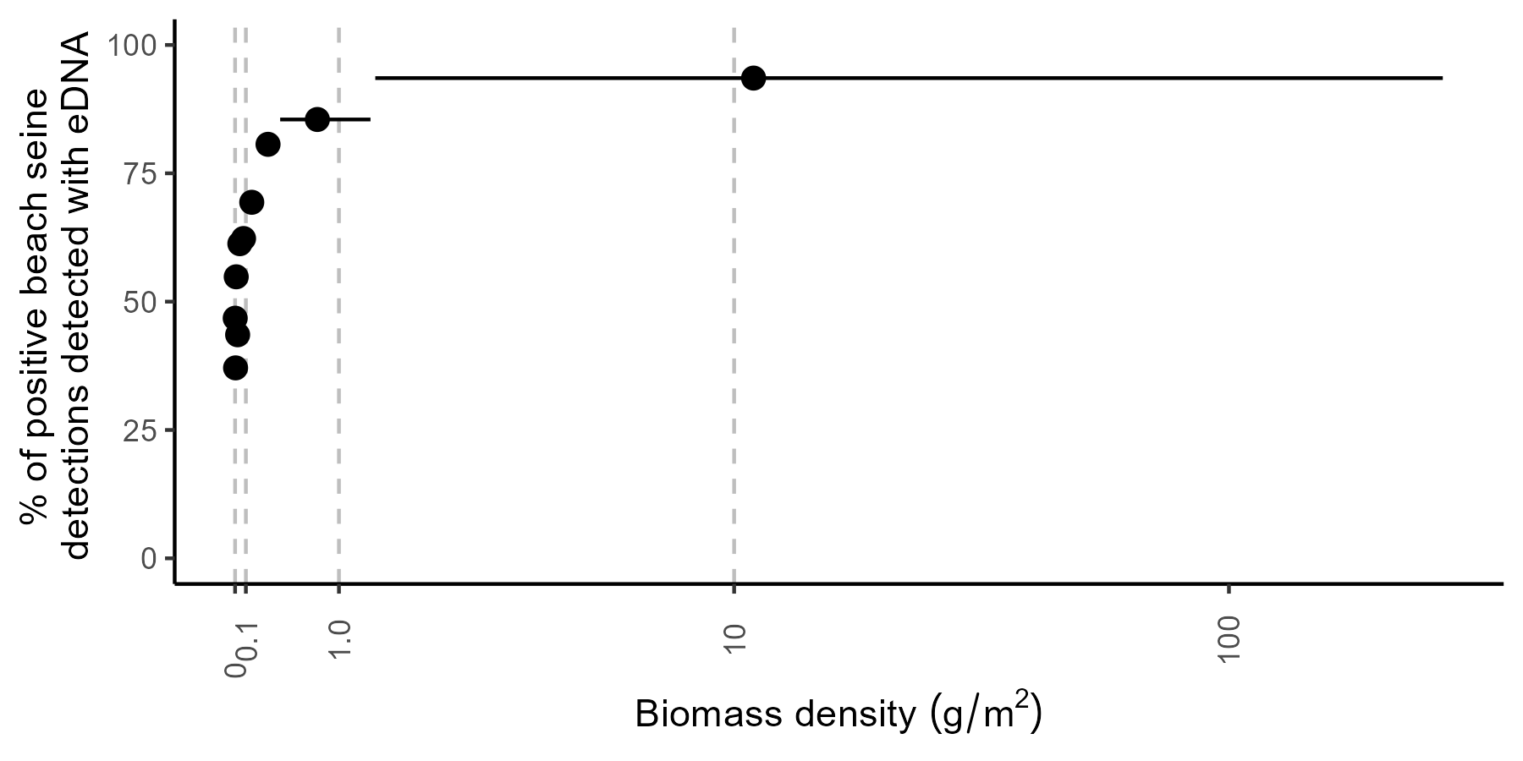
A
B
269
Local observations
detected with both methods (n = 386)
beach seine detection only (n = 233)
eDNA detection only (n = 682)
not detected with either method (n = 2517)
Regional observations
detected only with beach seining
detected only with eDNA
Beach seine biomass density g/m²
low biomass species

Slide 11
A
B
269
Local observations
detected with both methods (n = 386)
beach seine detection only (n = 233)
eDNA detection only (n = 682)
not detected with either method (n = 2517)
Regional observations
detected only with beach seining
detected only with eDNA
Beach seine biomass density g/m²
low biomass species

Slide 12
Region 1
Region 2
Site 1
A B C
A B D
Sample grain is equal or smaller than local habitat patchiness. Observed diversity shaped by local habitat – varying at small spatial scales.
Site 2
A B C
A B D
A B C
A B D
Sample grain spans multiple habitats. Observed diversity is shaped by habitat mosaic – varying at larger spatial scales.
Increasing sample grain
A B C
A B D
A B C
A B D
Sample grain spans multiple habitats and overlaps with another. Observed diversity is shaped by habitat mosaic. Adjacent samples are not independent.
A B C
A B D
Figure X. Hypothetical survey design highlighting issue of disentangling drivers of community dissimilarity across increasing sample graine. Two sites are sampled in two different regions made up of habitats A,B, and C in region 1 and A,B, and D in region 2. Habitats A and B. Do we find that habitat is the important driver, or the distance between sample locations. If habitat is found as the main driver, we know that our method is detecting differences at scales similar to that habitat’s patchiness on the landscape. Conversely, if we find that pairwise distance is more important in driving differences, it suggests that 1) eDNA may be homogenized over the shorter pairwise distances, or 2) eDNA may be homogenizing across multiple discrete habitats or environmental gradients that result in unique communities (A, B, and C, or A, B, and D).

Slide 13
Increasing sample grain
Habitat Mosaic
Habitats sampled
Observed diversity shaped by local habitat that may vary at small spatial scales. Nearby samples are distinct. Turnover is observable (and expected) over short or large distances.
Observed diversity shaped by habitat mosaic – varying at larger spatial scales. Nearby samples may appear homogenized. Little turnover is observable over short distances.
Observed diversity is shaped by habitat mosaic. Nearby samples overlap and are homogenized. Adjacent samples are not independent. Little turnover is observable over short distances.
Importance of local habitat
Importance of habitat mosaic (at increasingly larger scales)
Figure X. Hypothetical survey design highlighting some of the potential biases when observing ecological patterns (e.g., turnover) across different sample grains. Four sites are sampled across spatial and environmental gradients at increasingly larger sample grains. A) When sample grains span only single habitats, patterns in diversity associated with these habitats may be observed (even at short pairwise distances). B) When a sample grain spans multiple habitats, patterns in diversity associated with habitat may not me observed. Observed patterns may reflect emergent effects of the sampled area. Furthermore, emergent effects may be unique to certain areas or regions containing novel habitat features. C) When sample a sample grain overlaps with another, samples are homogenized and not independent.

Slide 14

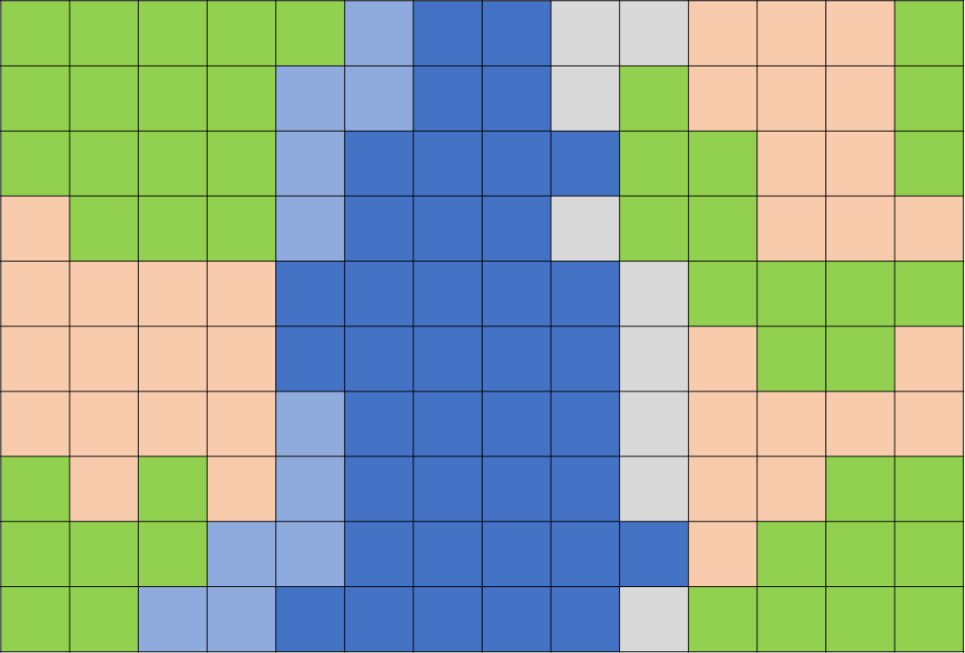
increasing sample grain
Observed diversity shaped by local habitat that may vary at small spatial scales. Nearby samples are distinct. Turnover is observable (and expected) over short or large distances.
A
B
C
habitat mosaic
habitats sampled
importance of local habitat
Observed diversity shaped by habitat mosaic – varying at larger spatial scales. Nearby samples may appear homogenized. Little turnover is observable over short distances.
importance of habitat mosaic
Figure 1. Hypothetical survey design highlighting some potential biases when observing ecological patterns (e.g., turnover) across different sample grains. Four sites are sampled across spatial and environmental gradients at increasingly larger sample grains. A) When sample grains span only single habitats, patterns in diversity associated with these habitats may be observed (even at short pairwise distances). Turnover is observable (and expected) over short or large distances. B) When a sample grain spans multiple habitats, patterns in diversity associated with habitat may not me observed. Observed patterns may reflect emergent effects of the sampled area. Furthermore, emergent effects may be unique to certain areas or regions containing novel habitat features. I.e., turnover may be low. C) When sample a sample grain overlaps with another, samples are homogenized and not independent.
Observed diversity is shaped by habitat mosaic. Nearby samples overlap and are homogenized. Adjacent samples are not independent. Little turnover is observable over short distances.

Slide 15
Observed diversity shaped by local habitat that may vary at small spatial scales. Nearby samples are distinct. Turnover is observable (and expected) over short or large distances.
Observed diversity shaped by habitat mosaic – varying at larger spatial scales. Nearby samples may appear homogenized. Little turnover is observable over short distances.
Observed diversity is shaped by habitat mosaic. Nearby samples overlap and are homogenized. Adjacent samples are not independent. Little turnover is observable over short distances.

Slide 16
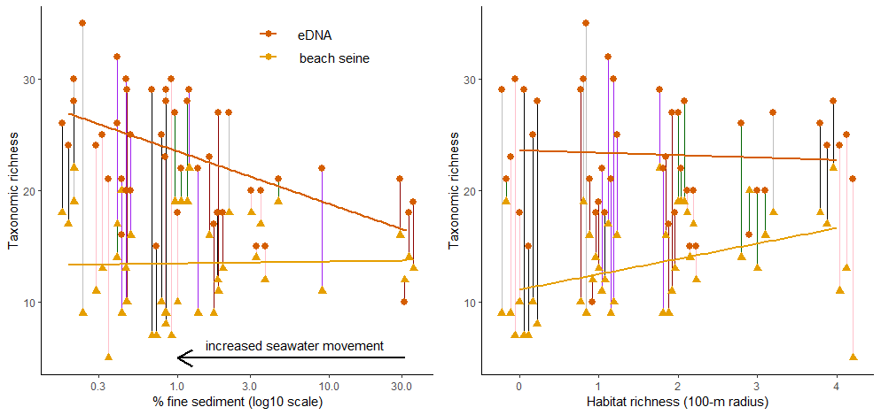

Slide 17
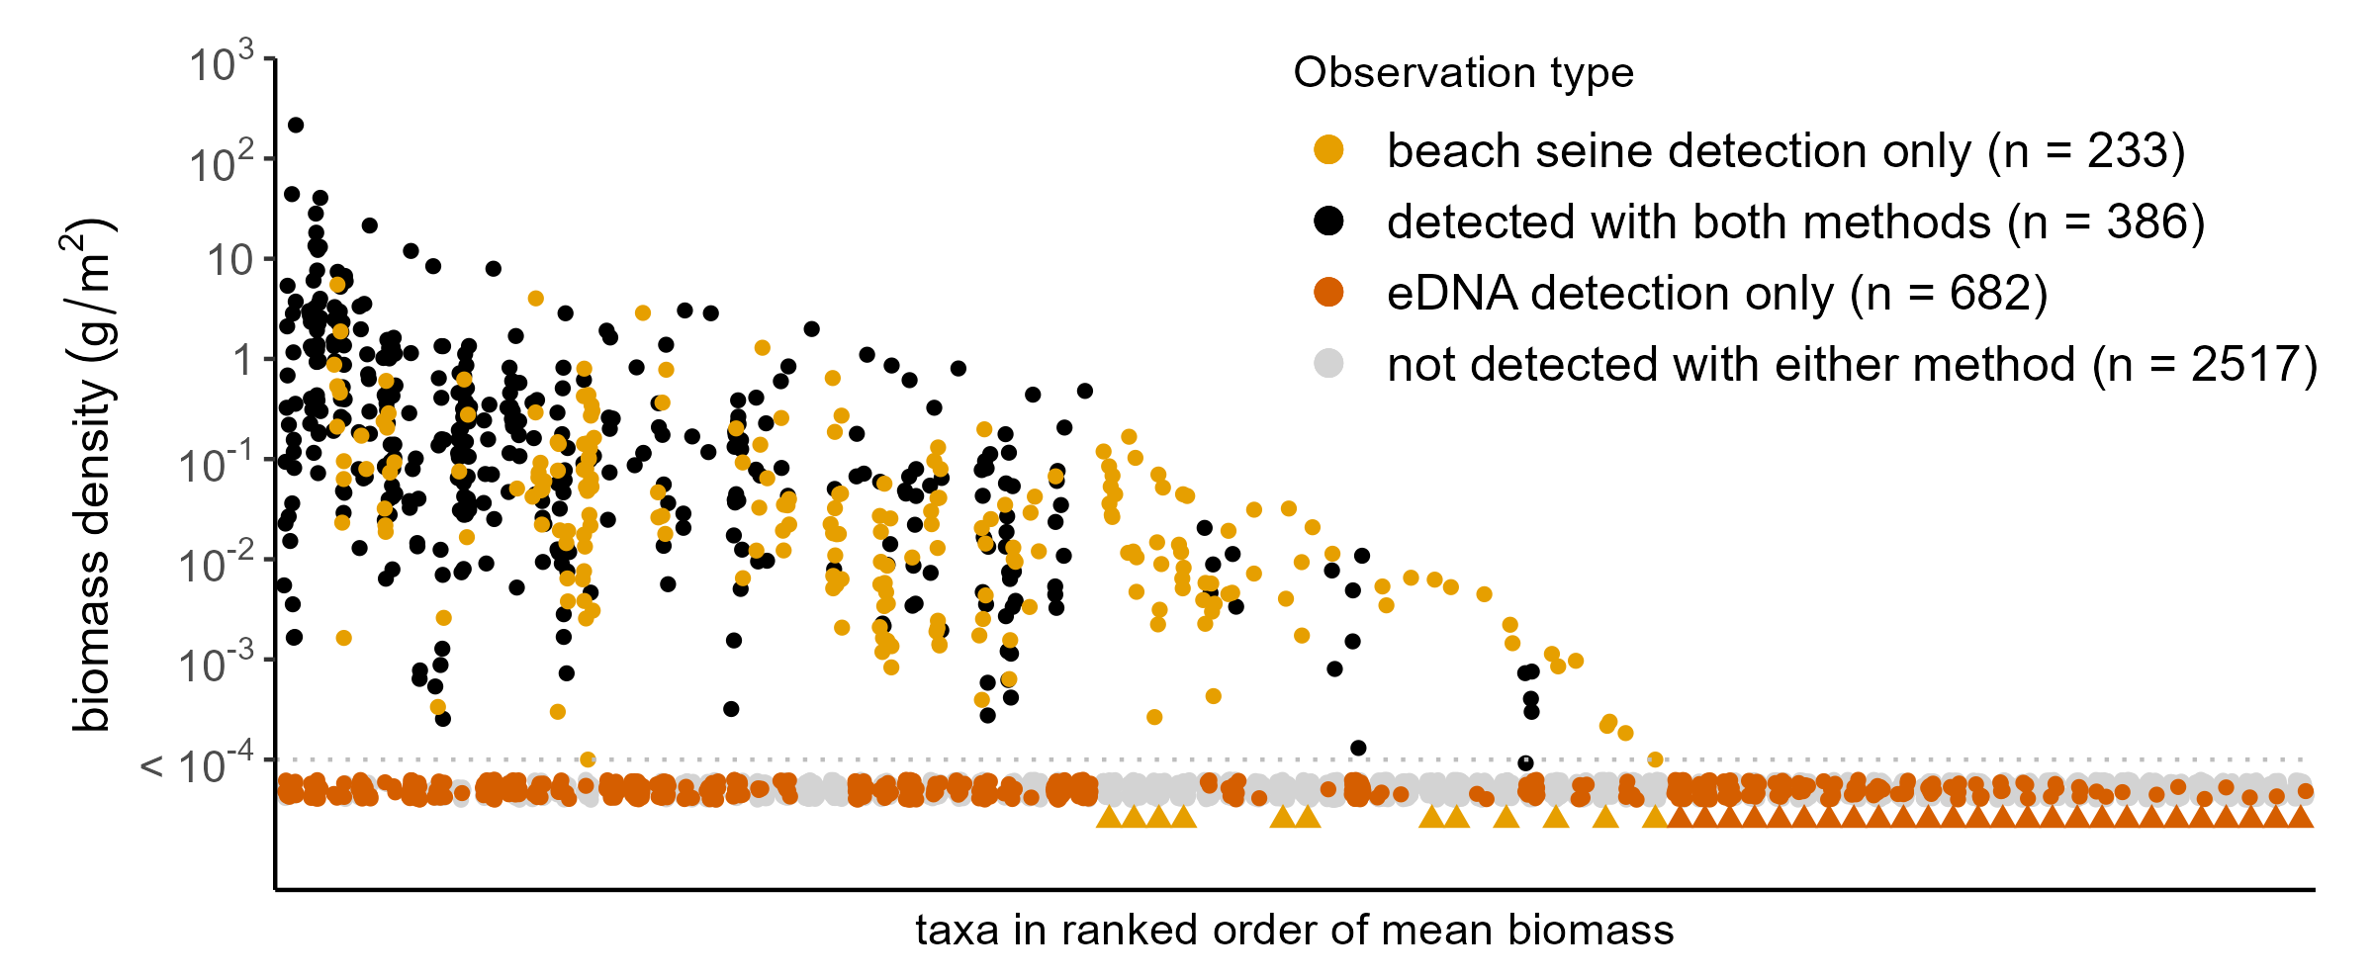
site level taxa detections
survey-wide taxa detections
eDNA only n = 682
both methods n = 386
26
44
12
beach seine only n = 233
not detected in any beach seine
never detected with eDNA

